Slide 1
The Development of an Open Source Physics Simulation for Flapping Wing Micro Air Vehicles
By
Netanel Fiorino
Advised By
Dr. Dirk M. Luchtenburg and Dr. Michelle Rosen
Notes:
I want to thank my professors for their expertise, guidance and advise throughout the past year. I want to thank my parents for enabling me to do this, and I want to thank my roommates and girlfriend for keeping me motivated and for dealing with all the stress in the past year.

Slide 2
Outline
Motivation
Model Development
Simulation Results
Model Verification
Conclusion

Slide 3
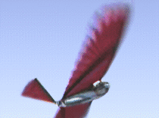
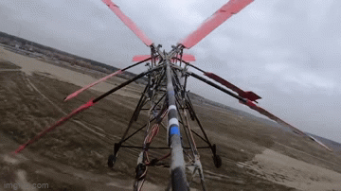
Motivation
Motivation
Model Development
Simulation Results
Model Verification
Conclusion
What are FWMAVs?
Why are we interested?
What’s out there?
Challenges
CUBIRD
Notes:
So what are FWMAVs? FWMAVs stand for flapping wing micro air vehicle. For centuries, scientists have studied and researched new and innovative methods of flying. The pursuit of efficient and versatile flight has led researchers to explore novel approaches in aerial vehicle design, such as ornithopters, VTOL (vertical takeoff and landing) drones, and UAVs (unmanned aerial vehicles).
So how have we ended up with FWMAVs?

Slide 4
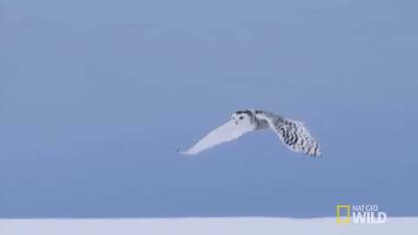
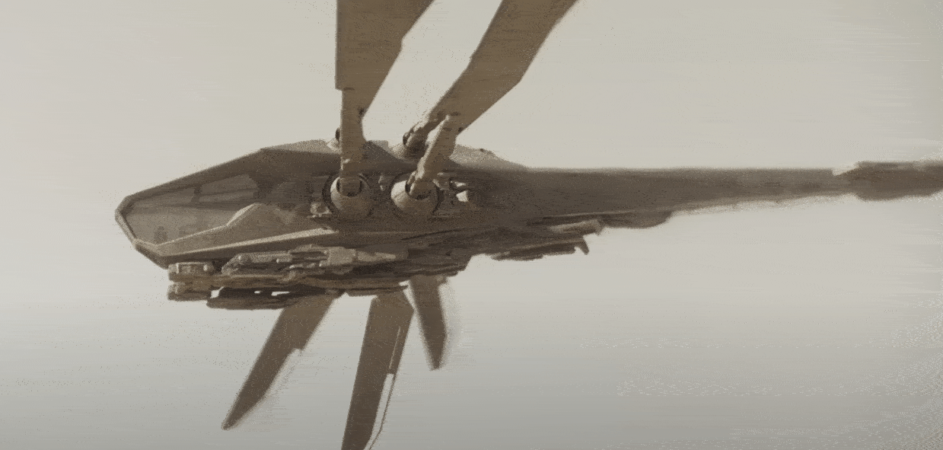
Motivation
Motivation
Model Development
Simulation Results
Model Verification
Conclusion
What are FWMAVs?
Why are we interested?
What’s out there?
Challenges
CUBIRD
Notes:
Biological systems have always been a source of inspiration in robotic designs. So what better way to gain inspiration than by looking at flyers in nature. Animals have been evolving for millions of years, and all flyers are seen to fly with flapping wings. Due to their lightweight nature and modulation of their wing kinematics, many insects and small birds exhibit high lift-to-power ratios, enhanced agility, and increased flight efficiency. Due to this, flapping winged robots have emerged as a promising avenue for achieving enhanced performances in flight, endurance, and maneuverability
There are some key advantages that FWMAVs have compared to to other flyers. Compared to fixed wing vehicles, FWMAV’s possess increased agility and manuverability, similar to Quadcoptors. But unlike quadcopters, FWMAVs have the potential to glide like a fixed wing vehicle. The method of flapping and flying is known as intermittent flight. In nature many flyers are seen to utilize intermittent flight to conserve energy. It allows FWMAV’s to take the best from both world, flight efficiency and manuverability.
Advantages
Intermittent flight
Energy Conservation During Gliding
Enhanced Maneuverability in Flapping
Enhanced mobility

Slide 5
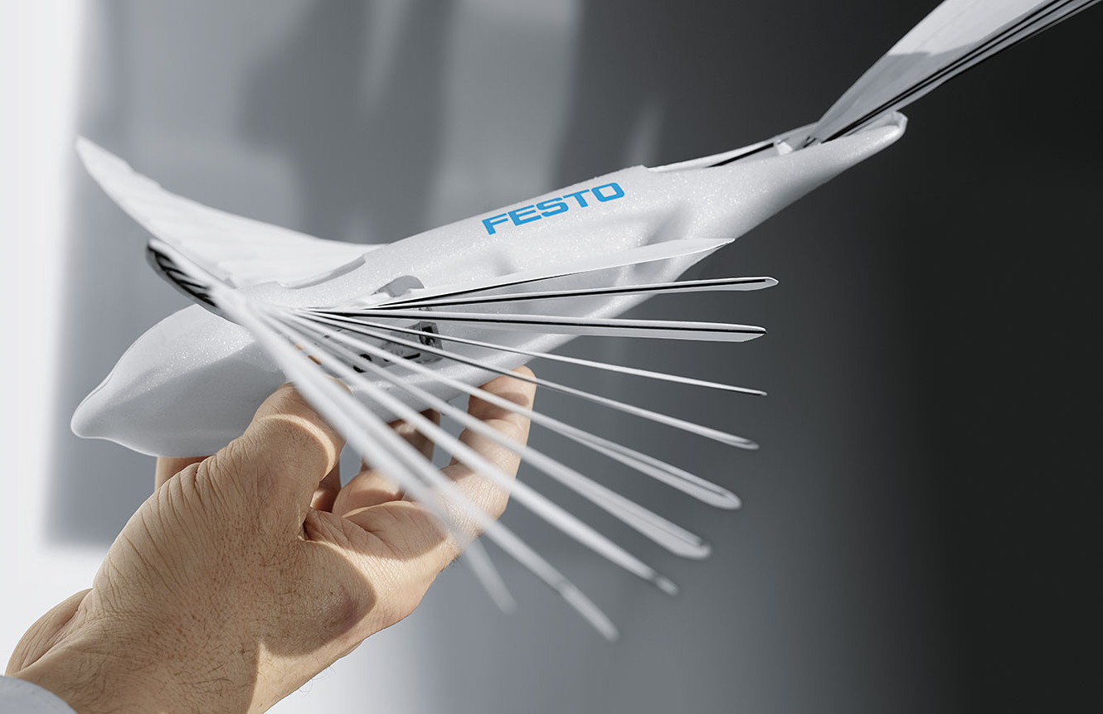
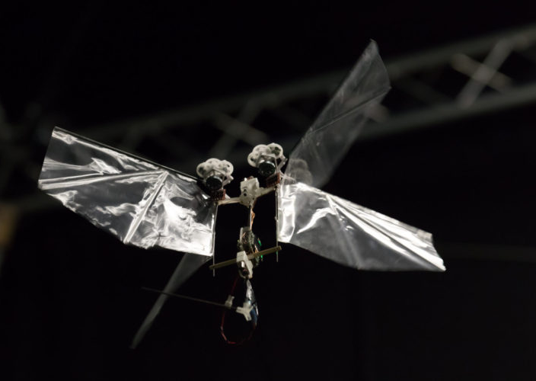
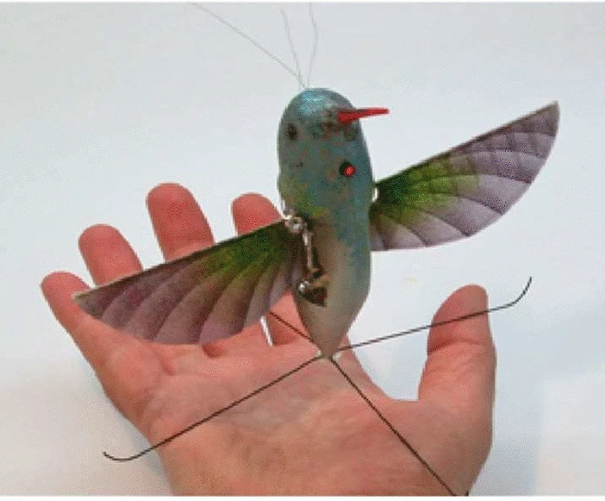
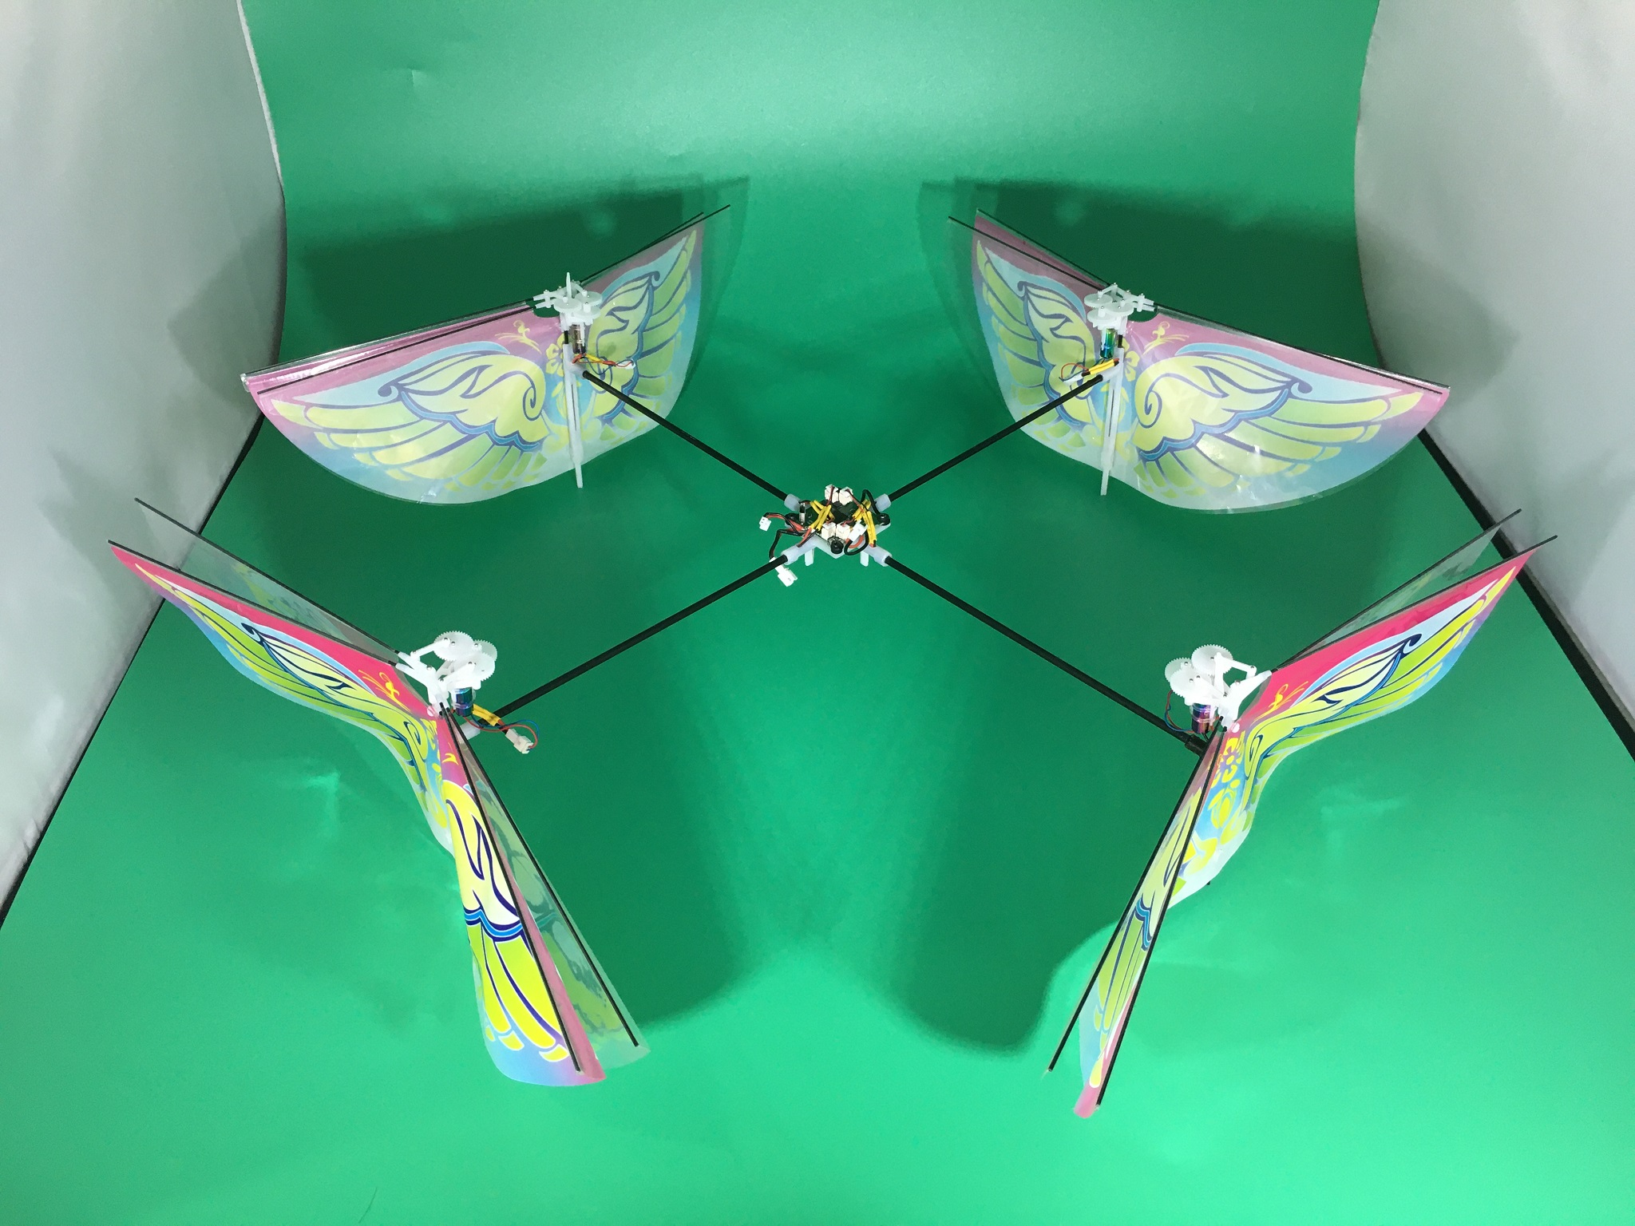
Motivation
Motivation
Model Development
Simulation Results
Model Verification
Conclusion
What are FWMAVs?
Why are we interested?
What’s out there?
Morphing Wing
Clap and Fling
Hovering
Flapping Drone
Challenges
CUBIRD
Festo
Delfly
AeroVironment
UC Irvine
Notes:
So whats is out there now? There are a wide variety of FWMAVs that come in all sorts of sizes with different flying mechanisms that ususually require their own simulation environments and modeling techniques. In the top left, is a FWMAV designed by Festo. This FWMAV has wings that morph, changing shape similar to a real bird. This allows for extreme precisions and accurate manuvers, but is an extremely complex system. Due to its unique design and flight mechanism, Festo had to develop their own simulation and modeling environment. To the fight of the Festo robot is a dragonfly inspired FWMAV called Delfly. The delfly uses a clap and fling mechanism to fly. While this is similar to flapping with two wings, the aerodynamics involved are actually different and require completely different aerodynamic models to correctly capture what occurs. The delfly relys on captured flight data and machine learning to model the aerodynamics, leading to a simulation that is tailored towards their specific robot. In the bottom left is a quadcoptor designed FWMAV, where instead of propellors, there are flapping wings. This is an incredibly unique design that uses that certainly doesn’t fall in the typically FWMAV design and required additional modeling. The bottom right shows a hummingbird inspired FWMAV, which focuses on hovering more than forward flight. Hovering FWMAV’s behave similar to quadcoptors, producing a thrust downwards, where there is little lateral movement. In forward flight, the aerodynamics change considerably because of the pitch of the vehicle and the speed at which it is traveling.
Overall, these 4 examples, are just a few of many uniquely designed FWMAVs being developed today. Each FWMAV was developed independently of each other and processes its own unique design.
Different scales, different flight mechanism
Each made their own simulation and aerodynamics- talk about modeling environment

Slide 6
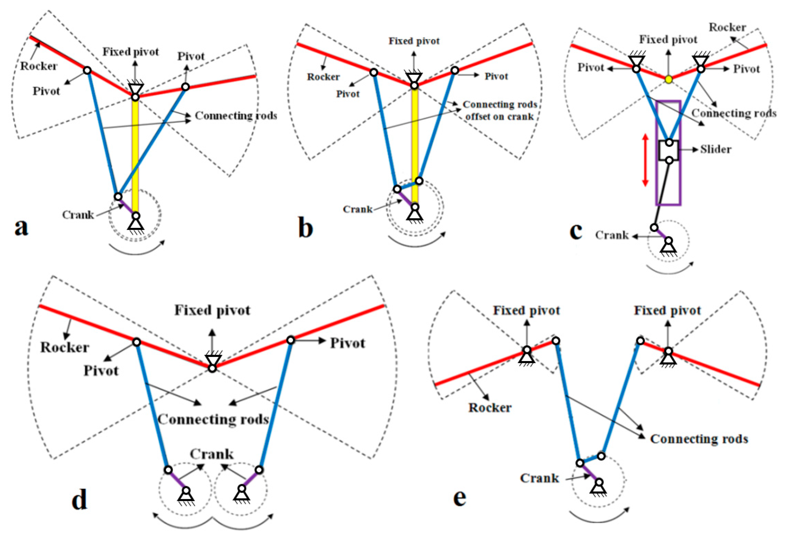
Motivation
Motivation
Model Development
Simulation Results
Model Verification
Conclusion
What are FWMAVs?
Why are we interested?
What’s out there?
Challenges
Lack of Open Source Design Tools
Different Flapping Mechanisms
Wide Variety in Sizes and Designs
Understudied Aerodynamics compared to fixed wing
Hovering vs Forward Flight
CUBIRD
Notes:
Insert picture
So as I briefly mentioned, there are a lot of challenges in the FWMAV field. The first is that there is a lack of open source design tools. A quick google will give plenty of DIY guides for developing drones and quadcopters, but none exist for FWMAVS.
There is also the issue of different flapping mechanisms. Although they are all flapping, the aerodynamics behind the scenes can be quite different
There are also a large variety of sizes and designs that need to be uniquely captured
The fourth is that the aerodynamics are understudied compared to fixed wing vehicles and propellor based vehicles

Slide 7
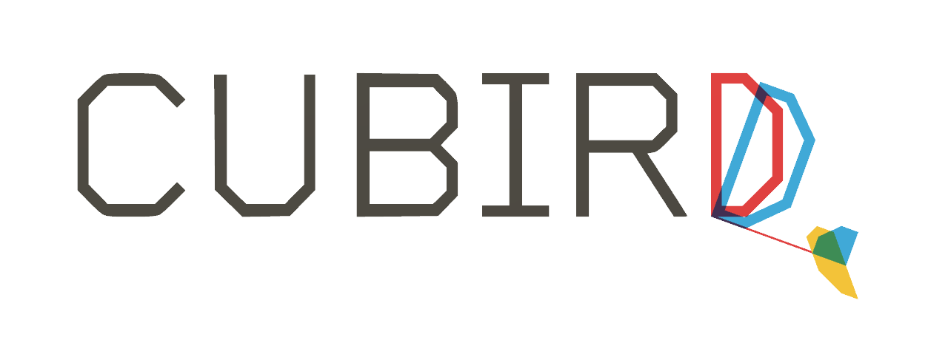
Motivation
Motivation
Model Development
Simulation Results
Model Verification
Conclusion
What are FWMAVs?
Why are we interested?
What’s out there?
Challenges
CUBIRD
Open Source
Cheap
Accessible
Energy Conservation
Notes:
Talk to logan and get pictures
And that brings us to CUBIRD. CUBIRD stands for Cooper Union Bio-Inspired Robotic Design. The goal of the cubird project aims to address 3 challenges in the world of FWMAVs and to further research energy conservation through intermittent flight, we want to develop open source, accessible and cheap FWMAVS. For the everyday hobbyist, developing a FWMAV is a near impossible task. For one it is time consuming, as the FWMAV’s were developed by teams rather than individuals, and it can be expensive process of buying and designing parts. On top of the time and money commitment, There are no open source tools for testing designs or developing control algorithms. Many research based FWMAV have their code hidden, and have their simulation environments tailored towards there specific robot.
There are a variety of projects going on for the overall CUBIRD project. A close friend of mine is developing an open source transmition system, and other students are building test stands. My interest lied in developing a simulation particularly for forward flight.
Mention I focus on simulation rather than building, other students are building
I am interested in making a simulation to design and verify these vehicles, particularly in forward flight

Slide 8
Research Goals
Motivation
Model Development
Simulation Results
Model Verification
Conclusion
Develop a simulation tool for CUBIRD that is:
Adaptable to Different FWMAVs
Open Source
Modular
Usable as Design Tool
Verifiable with Real World Data
Notes:
Insert picture

Slide 9
Model Development

Slide 10
Dynamical Model
Motivation
Model Development
Simulation Results
Model Verification
Conclusion
External Environment
Sensors
Forces and Moments
Body Dynamics
Control Algorithm
FWMAV Aerodynamics
Wing Kinematics
Actuator Dynamics
Notes:
Background on how simulation environments typically work

Slide 11
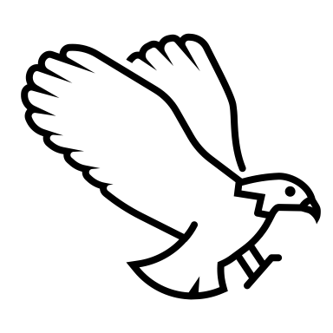
How can we model and predict flight?
Motivation
Model Development
Simulation Results
Model Verification
Conclusion
y
x_{body}
Θ
x
O
Notes:
Degrees of freedom
Talk about state, position and velocity for each degree of freedom

Slide 12
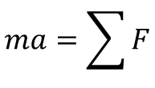
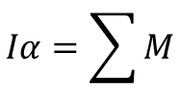
Rigid Body Dynamics
Motivation
Model Development
Simulation Results
Model Verification
Conclusion
Newton’s Second Law
y_{body}
$$ma=\sum{F}$$
y
x_{body}
$$Iα=\sum{M}$$
F_{Wing-y}
α
v_{body}
F_{Wing-x}
r_{wing}
Θ
F_{Tail-y}
r_{tail}
y_{tail}
F_{Gravity}
Θ_{tail}
x_{tail}
F_{Tail-x}
x
O
Notes:
N2 can be split into each degree of freedom, giving the equations of motion for each degree of freedom. Gravity acts downwards in the global frame at the center of mass of the FWMAV. The tail aerodynamic force occurs at the center of pressure of the tail, and the Wing force occurs at the wing shoulder, which is where the wing is attached to the body. There is also a moment generated by the offset of the wing and tail force from the COM of the FWMAV. So we know we have these 3 forces, but how do we get them.

Slide 13
Different Reference Frames Used
Motivation
Model Development
Simulation Results
Model Verification
Conclusion
Global Frame
Body Frame
Wing Frame
Stability Frame
Tail Frame
y
F_{Wing-y}
r_{wing}
F_{Tail-y}
r_{tail}
F_{Wing-x}
F_{Gravity}
F_{Tail-x}
x
O
Notes:
Before jumping into the physics equations, its important to understand the reference frames used. These frames serve as coordinate systems relative to which forces and motions are defined and transformed
The global Frame is where we will be applying Newtons laws of Motion. In N2, all the forces are expressed in the frame in which we are working, the distance along the x axis is the horizontal distance traveled when looking at the FWMAV as an observer and the y distance is the height of the FWMAV

Slide 14
Different Reference Frames Used
Motivation
Model Development
Simulation Results
Model Verification
Conclusion
Global Frame
Body Frame
Wing Frame
Stability Frame
Tail Frame
y_{body}
y
x_{body}
F_{Wing-y}
α
v_{body}
F_{Wing-x}
r_{wing}
Θ
F_{Tail-y}
r_{tail}
F_{Tail-x}
F_{Gravity}
Θ_{tail}
x
O
Notes:
The body frame is located at the center of mass of the body and the x-axis points towards the front of the vehicle. This frame is useful for calculating the moments causing the rotation of the FWMAV, since the forces can be broken up into x and y components relative to the body.

Slide 15
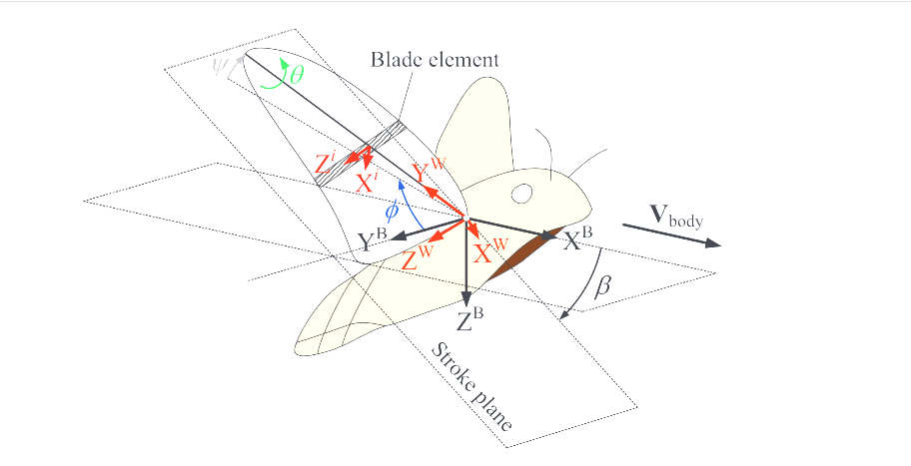
Different Reference Frames Used
Motivation
Model Development
Simulation Results
Model Verification
Conclusion
Global Frame
Body Frame
Wing Frame
Stability Frame
Tail Frame
Notes:
The wing frame is used for calculating the forces caused from flapping. The wing undergoes 4 rotations from the body frame. Beta- the stroke plane angle, phi- the stroke angle, theta- the rotation angle, and psi- the deviation angle. The x-axis of the wing is perpendicular to the wing’s surface

Slide 16
Different Reference Frames Used
Motivation
Model Development
Simulation Results
Model Verification
Conclusion
Global Frame
Body Frame
Wing Frame
Stability Frame
Tail Frame
y
Lift_{body}
v_{body}
Lift_{tail}
Drag_{body}
Drag_{tail}
v_{tail}
x
O
Notes:
The stability frame is where the lift and drag forces are calculated an expressed. The drag always opposes the direction of the velocity. Each surface has its own stability frame based on the incident velocity

Slide 17
Different Reference Frames Used
Motivation
Model Development
Simulation Results
Model Verification
Conclusion
Global Frame
Body Frame
Wing Frame
Stability Frame
Tail Frame
y
x_{body}
y_{body}
v_{body}
F_{Tail-y}
α_{body}
y_{tail}
v_{body}
Θ_{tail}
x_{tail}
α_{tail}
F_{Tail-x}
x
O
Notes:
The aerodynamic force on the tail is rotated to be in the tail’s reference frame by the angle of attack. Different parts of the FWMAV will have different angles of attack depending on the surface angle and the velocity at that surface

Slide 18
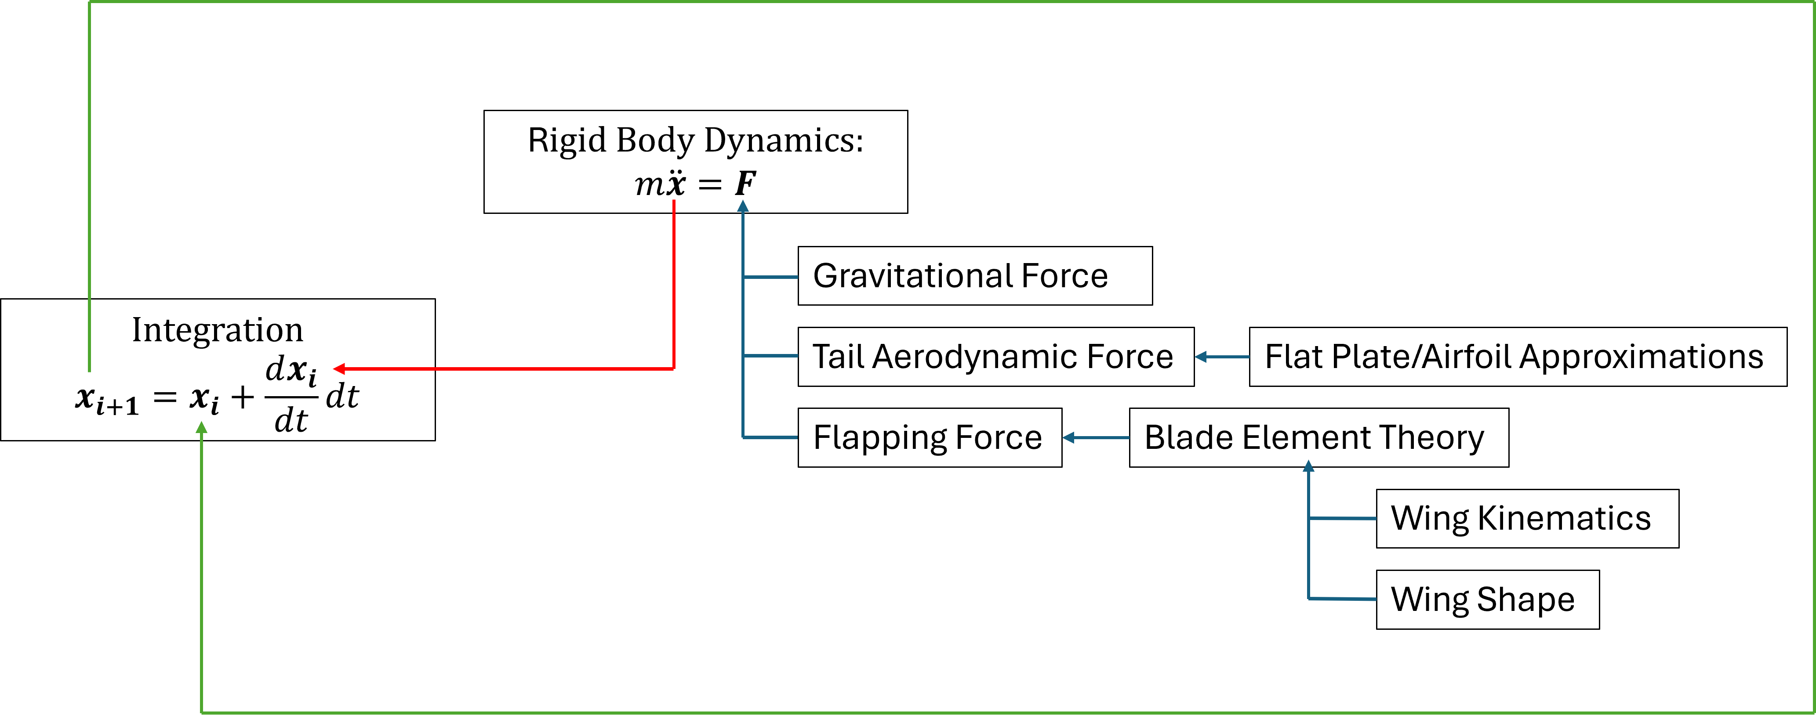
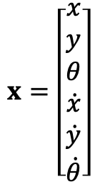
How can we model and predict flight?
Motivation
Model Development
Simulation Results
Model Verification
Conclusion
$$x=\left[\begin{aligned}x \\ y \\ θ \\ \dot{x} \\ \dot{y} \\ \dot{θ}\end{aligned}\right]$$
Notes:
State and integration
Talk about how each function in my simulation is a separate file and function so that they can easily be changed
Explain what blade element theory is and why it is useful

Slide 19
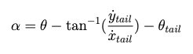
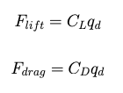
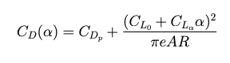
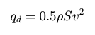
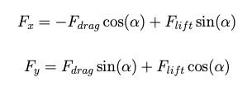
Flat Plate Aerodynamics
Motivation
Model Development
Simulation Results
Model Verification
Conclusion
x_{body}
y_{body}
v_{body}
y_{tail}
α_{body}
Θ_{tail}
α_{tail}
v_{tail}
x_{tail}
Angle of Attack
Lift and Drag Coefficients
Lift and Drag Forces
Forces in the Surface Frame
Notes:
Flat Plate aerodynamics were used to simulate the effects on the tail. At low angles of attack, the aerodynamic model incorporates a combination of flat plate approximations and airfoil approximations to better simulate the aerodynamics.
The aerodynamic calculations start will determining the angle of attack of the surface. The equation here is specifically for the tail. The tails angle of attack is the FWMAV pitch minus the tail angle, minus the angle of the velocity vector.
The lift and drag coefficients are functions of the aerodynamic surface and the angle of attack
Thos coefficients are used to determine the lift and drag forces, in the direction of the velocity.
Finally, the lift and drag forces are converted to x and y forces in the surfaces reference frame
Determined angles of attack and followed generic form

Slide 20
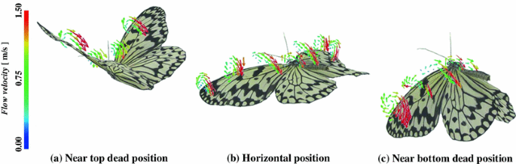
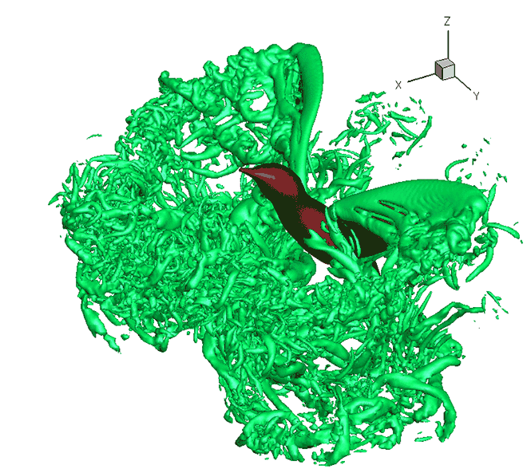
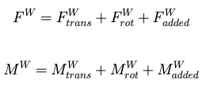
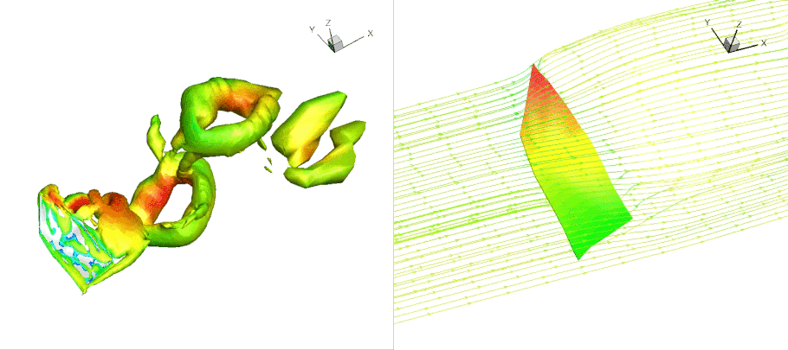
Flapping Aerodynamics: Methods
Motivation
Model Development
Simulation Results
Model Verification
Conclusion
Unsteady
Quasi Steady
Testbench data
What is used in the Simulation?
Notes:
Flapping causes flight by creating vortices the shed along the surface of the wing. These vortices produce zones of different pressure that cause a lift and drag force. As you an see, the air movement around a flapping wing is complex. But we need a way to model it.
There are two main types of numerical aerodynamic models, quasi-steady and unsteady.
Quasi-steady models assume that the aerodynamic forces and moments acting on an object remain constant over small time intervals. It simplifies the analysis by treating the aerodynamic forces as though they are steady, even though the actual flow around the object may be changing over time. It is a simplified approximation, which implies that the aerodynamic forces and moments depend only on the instantaneous motion of the body surface
Unsteady models, on the other hand, explicitly account for the time-varying nature of aerodynamic forces and moments. Unsteady aerodynamic models incorporate the complex interactions between the object and the surrounding airflow as they evolve over time, providing a more accurate representation of aerodynamic behavior at the cost of higher computational costs. They can include wake capture, vortices, flow separation and many more.
Using testbench data is the most accurate way of understanding and recording behavior, but this is often in a controlled environment and small adjustments to the physical design of the FWMAV can alter recorded results.
I am using a combination of quasi steady and unsteady. The effects captured in the model or translational, rotational, and added mass. Explain what each are. I employ a blade element theory to break the wing down into multiple elements and calculates the force from each section.

Slide 21
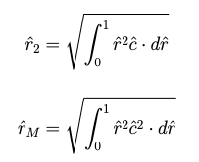
Flapping Aerodynamics: Wing Shape
Motivation
Model Development
Simulation Results
Model Verification
Conclusion
y
y'
x_{r}
r'
y_{LE}(r’)
r_{i}
y_{i}
z_{w}
y_{w}
y_{r}
z_{i}
c_{i}*
x
O'
c(r’)
COM
dr
R
Notes:
The shape of the wing drastically changes the flapping forces. A general wing shape is used to allow for the simulation to be adaptable to FWMAVs of all shapes and sizes. This picture has the wing shape coordinate system, and the coordinate system used for blade element theory. Each blade element is at a distance r’ from the wing root
The origin is the shoulder, where the rotations occur, the y’ and r’ origin is the wing root, and r’ is the pitching axis. For simplicity, the wing shape can be defined to incorporate any offsets in the wing root to the shoulder.
The defining parameters are the Wing length, the Aspect ratio which is R^2/Area, the leading edge function, and the chord length function.
The two functions on the right are the 2nd moment of area, and the moment of the 2nd moment of area, used in the aerodynamic calculations.
The shape of the wing effects the aero calculations in two ways, one is that the blade elements will have different areas and different forces acting on them but also the coefficients rely on the r^2 value

Slide 22
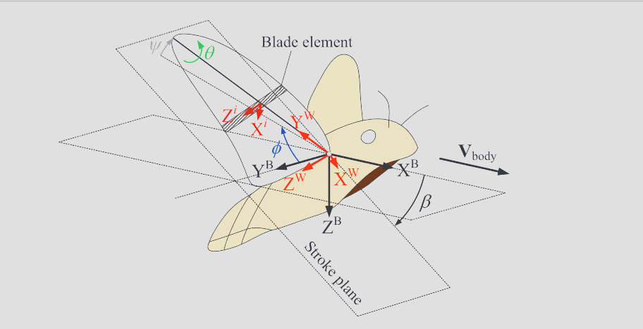
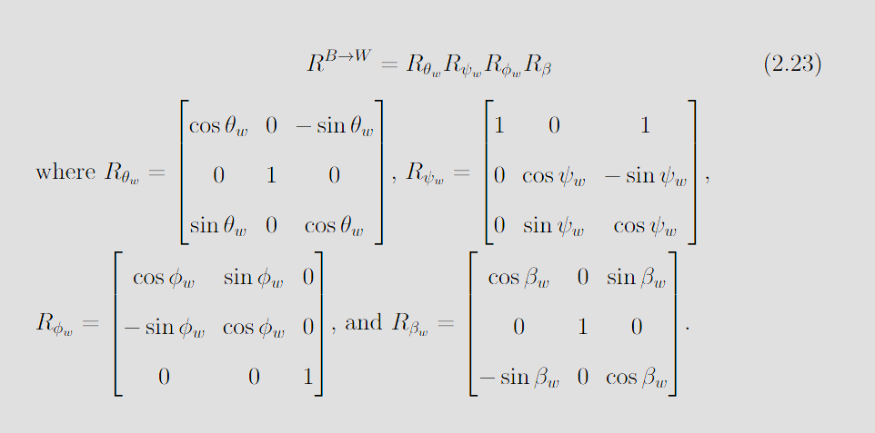
Flapping Aerodynamics: Rotations
Motivation
Model Development
Simulation Results
Model Verification
Conclusion
Notes:
Going back to our reference frame, we can look at it a bit more in depth.
Mention the blade element

Slide 23
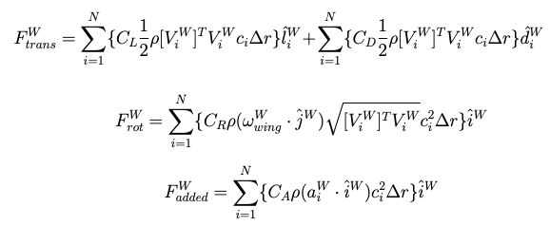
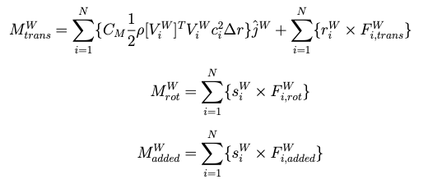
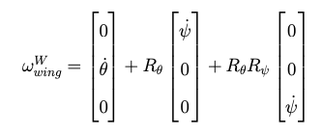
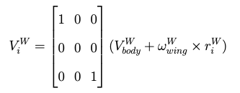
Flapping Aerodynamics: Forces
Motivation
Model Development
Simulation Results
Model Verification
Conclusion
Notes:
Make sure I mention that each calculation is for each blade element and they get added
Each wing has different velocity but they all have same angular rotation
Each of the main terms have a coefficient related to it. The two moments without a coefficient are due to the moment arm

Slide 24
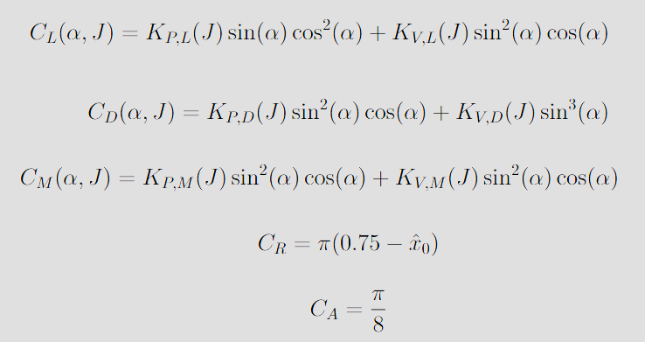
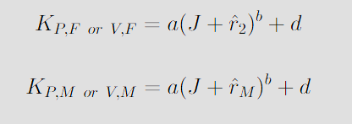
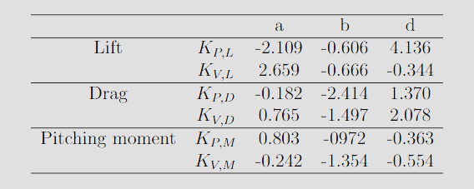
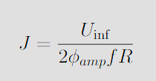
Flapping Aerodynamics: Coefficients
Motivation
Model Development
Simulation Results
Model Verification
Conclusion
Notes:
This model takes into account the leading edge vortices and the vortex potential generated during flapping and is a function of the advance ratio (J), the angle of attack (α), the non-dimensional second moment of the wing area (ˆr2), and ˆrM.
In the model, the values of KV , the correction factor referring to the leading edge vortices, decrease as the forward flight speed increases. This demonstrates the degradation of the vorticity of the leading edge vortex and corresponding lift and drag forces during forward flight.

Slide 25
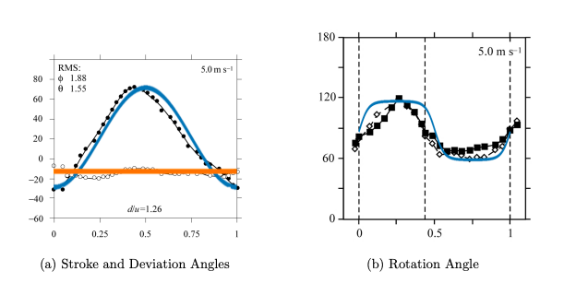
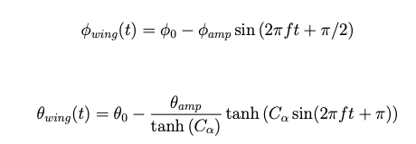
Wing Kinematics
Motivation
Model Development
Simulation Results
Model Verification
Conclusion
Notes:
We saw that the forces depend on the velocity and rotation of the wing, but how doe we get this. To accurately produce the thrust and lift forces that enable forward flight, accurate wing rotational kinematics had to be devised that represents the motion of a biological flyer’s wings in forward flight. Because CUBIRD is looking at biology for inspiration, the wing kinematics will likely follow similar patterns to those found in nature.
The underlying graph is the flapping profile of a Hawkmoth flying at 5 m/s
These wing kinematic equations can be changed an updated to the kinematics of the FWMAV being examined

Slide 26
Simulation Results

Slide 27
Simulation Parameters
Motivation
Model Development
Simulation Results
Model Verification
Conclusion
FWMAV Physical Parameters | Mass, Moment of Inertia, FWMAV Length, Tail Distance, Shoulder Distance, Tail Size, Tail Angle, Flapping Frequency
Wing Parameters | Wing Length, Wing Aspect Ratio, Leading Edge Function, Chord Length Function
Wing Kinematics | Starting Angle, Average Angle, Sweeping Amplitude
Simulation Environment | Number of Time Steps per Period, Number of Periods, Number of Blade Elements
Notes:
This allows for FWMAV’s of all sorts of sizes and designs to be simulated.

Slide 28
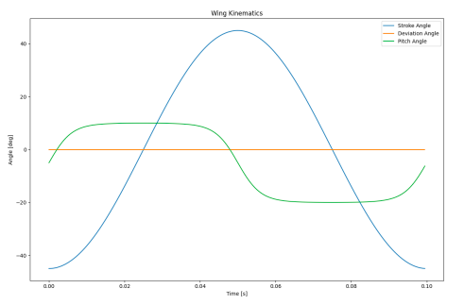
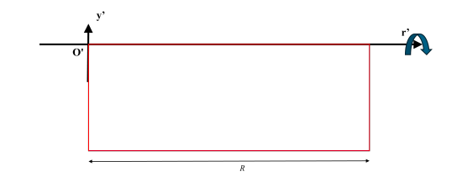
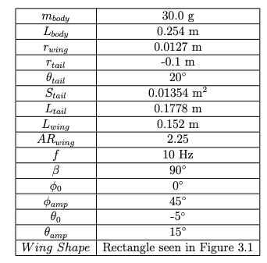
Parameter Study: Baseline Conditions
Motivation
Model Development
Simulation Results
Model Verification
Conclusion
Notes:
The goal of testing different paramters is for two reasons. One is to ensure that the simulation behaves as expected, but also to see the effects that each of these changes have and how impactful it is on the overall flight
These parameters were largely found through trial and error but were focused around having a mass of 30 grams and a flapping frequency of 10 Hz which is the scale that CUBIRD is developing their FWMAV.

Slide 29
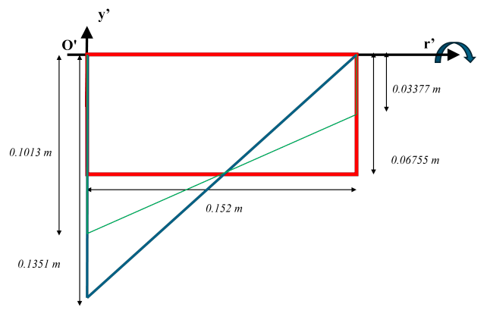
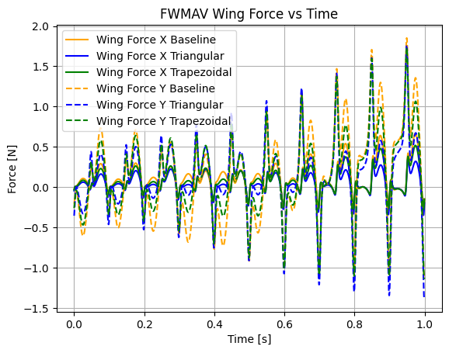
Effects of Wing Shape
Motivation
Model Development
Simulation Results
Model Verification
Conclusion
Notes:
3 Wing shapes were used, the baseline rectangle seen before, a triangle, and a trapezoid. Each wing was the same length and had the same area.
Here, the Baseline wing had the highest flapping forces in the x and y directions in the upstroke and downstroke. This makes sense because there is more surface area at the end of the wing, and the end of the wing experiences the highest velocity, giving it the greatest aerodynamic force

Slide 30
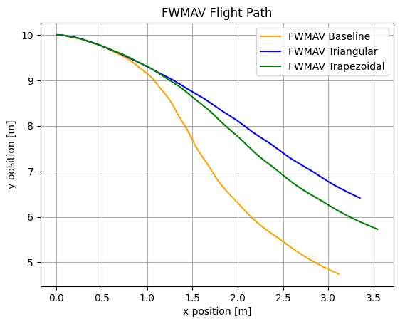
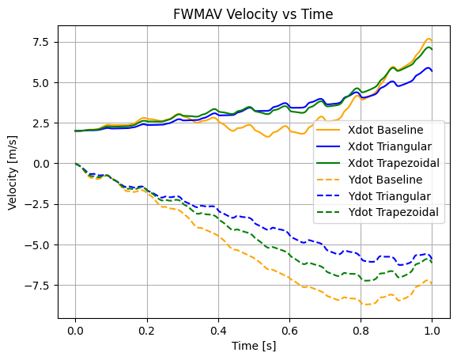
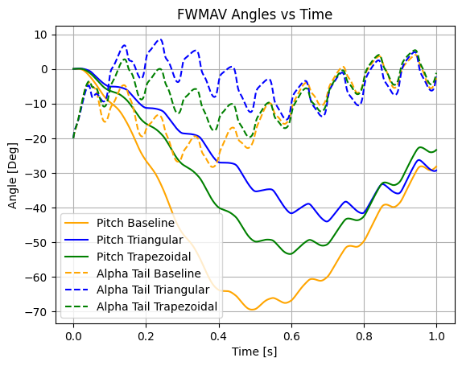
Effects of Wing Shape
Motivation
Model Development
Simulation Results
Model Verification
Conclusion
Notes:
Even though the rectangular wing had the highest force, it didn’t travel the furthest. The different forces cause the FWMAV to rotate different amounts, changing the angle of attack and the direction the FWMAV is traveling in. It is a self feedback loop, making the trajectory difficult to predict, which highlights the need for a simulation environment that can be used as a design tool to test FWMAV designs

Slide 31
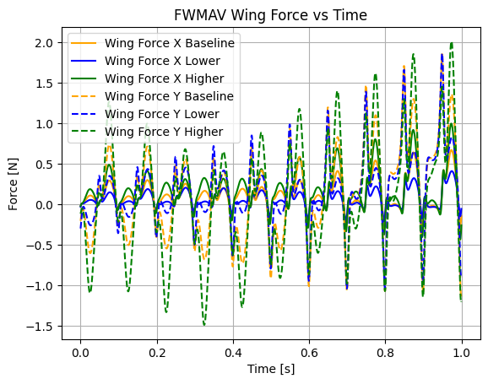
Effects of Stroke Amplitude
Motivation
Model Development
Simulation Results
Model Verification
Conclusion
Baseline = 90°
Higher = 120°
Lower = 60°
Notes:
In the base the FWMAV swept from -45 to 45 having a tip to tip amplitude of 90 degrees. Here the effects of changing the amplitude to 120 degrees and 60 degrees was examined.
The forces of the larger amplitude is higher in all cases because the wing has to move faster to cover a larger distance in the same time period.

Slide 32
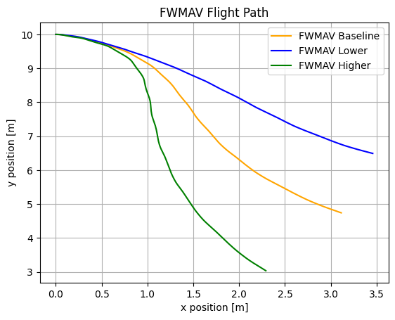
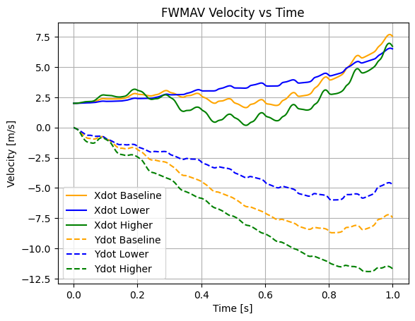
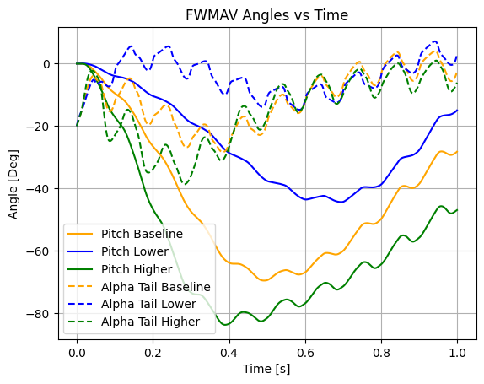
Effects of Stroke Amplitude
Motivation
Model Development
Simulation Results
Model Verification
Conclusion
Notes:
Higher had a tip to tip amplitude of 120
Lower had a tip to tip amplitude of 60
Smaller oscillations in lower, and behaves more like a glider, it has smoother motion

Slide 33

Effects of Rotation Amplitude
Motivation
Model Development
Simulation Results
Model Verification
Conclusion
Baseline = 30°
Higher = 40°
Lower = 20°
Notes:
Smaller rotation angle had lower force in the x and higher in the y because of the angle of attack. During the upstroke and downstroke, the wing is flatter. There are spikes when the higher rotation angle has higher forces caused by the larger rotation of the wing

Slide 34



Effects of Rotation Amplitude
Motivation
Model Development
Simulation Results
Model Verification
Future Work
Notes:
Higher had an amplitude of 40
Lower had an amplitude of 20

Slide 35

Effects of Flapping Frequency
Motivation
Model Development
Simulation Results
Model Verification
Conclusion
Baseline = 10 Hz
Higher = 20 Hz
Lower = 5 Hz
Notes:
Higher was 20 hz, lower was 5 Hz
The higher frequency had significantly higher forces

Slide 36



Effects of Flapping Frequency
Motivation
Model Development
Simulation Results
Model Verification
Conclusion
Notes:
Higher is 20 Hz
Lower is 10 Hz
Obv very different trajectories. You can see the effects of the different frequencies tho. More oscillations in the higher frequency

Slide 37



Effects of Tail Distance
Motivation
Model Development
Simulation Results
Model Verification
Conclusion
Baseline = 0.1m, Longer = 0.125m, Shorter = 0.075m
Notes:
Longer was 0.125 m
Shorter was 0.075 m
Longer tail increases stability

Slide 38
Model Verification
Notes:
So while the simulation seemed to be producing reasonable results, it is imperative to compare the simulation with a real life FWMAV

Slide 39



Zing Banshee Overview
Motivation
Model Development
Simulation Results
Model Verification
Conclusion
Notes:
For this, a FWMAV was purchased from amazon.
Explain how I got the parameters
There was no details on the physical parameters of the FWMAV, so all values were approximated
The wings are connected to one another, rather than two distinct wings
The wings, body, and tail are made of fabric are are therefore non-rigid
Explain how I recorded the data
markers were attached each weight 1.28 grams
The FWMAV was thrown in the Vicon MoCap room, where the position and rotation of the FWMAV can be recorded.

Slide 40


FWMAV Flapping
Motivation
Model Development
Simulation Results
Model Verification
Conclusion
Notes:
The wings are made from fabric and changes morophology while flapping. The aerodynamic model used relies on rigid wings, so it might be problematic
Mention that a flight test was done with the rigid wings, but a second test was done after reenforcing the wings

Slide 41

Reinforced FWMAV Overview
Motivation
Model Development
Simulation Results
Model Verification
Conclusion
15 Trials
Increased Rigidity
Different Flapping Frequency
Different Rotation Angle Amplitude
Notes:
Carbon fiber rods were added to the FWMAV to increase rigidity in the wings due to its high strength to weight ratio.
15 trials were conducted, the FWMAV was thrown with different pitch angles and different initial speeds to capture a wide range of data, with the goal to ensure that the simulation worked for many conditions.
Overall the simulation matched the real world data well. You can never expect a perfect simulation, especially with complex aerodynamics, but the simulation lends itself to visualizing the trends seen in the real world.

Slide 42

Best Result
Motivation
Model Development
Simulation Results
Model Verification
Conclusion
Notes:
Flight Path follows a similar trend, velocities are similar. Angle of attack and pitch follows a similar trend.
Mention what the green line is
Mention initial conditions:
Mention Oscillations
The x velocity difference can be attribute to the more steady pitch of the FWMAV in simulation. The differences can be attributed to different body aerodynamics and different wing kinematics

Slide 43

Mediocre Result
Motivation
Model Development
Simulation Results
Model Verification
Conclusion
Notes:
Here the simulation differed from the real world data, but similar trends can be seen. The pitch rate follows a similar patter, but with some delay, which can also be seen in the pitch. The Simulation over estimates the x velocity, but underestimates the z velocity. One aspect that effected all the simulations is that the wing kinematics were estimated from a slow motion video of the FWMAV flapping in still air, while moving however, the kinematics may change.

Slide 44

Worst Result
Motivation
Model Development
Simulation Results
Model Verification
Conclusion
Notes:
When the FWMAV started at a low angle of attack -50 degrees, the simulation and real world data were most different.

Slide 45
Conclusion

Slide 46
Takeaways
Motivation
Model Development
Simulation Results
Model Verification
Conclusion
Positives
Flapping force model works correctly, changes in the kinematics and shape effect the force as expected
For non-extreme initial conditions, the simulation gives a good ballpark of what happens in real life
The simulation is adaptable to different wing shapes and kinematics
Limitations
Model requires rigid wings
Does not capture the body aerodynamics
Only models the effects of flapping from two distinct wings
Ignores the effect of the wind on the wing kinematics

Slide 47
Future Work
Motivation
Model Development
Simulation Results
Model Verification
Conclusion
Test stand with a force sensor to measure flapping forces
Create better aerodynamic functions that incorporate different body shapes
Test with a FWMAV that has its physical parameters better detailed
Implement a periodic trim condition search

Slide 48
Conclusion
Motivation
Model Development
Simulation Results
Model Verification
Conclusion
✓
Adaptable to Different FWMAVs
Open Source
Modular
Usable as Design Tool
Verifiable with Real World Data
✓
✓
✓
✓
Notes:
Different wing shapes, masses and length can be implemented to allow for the simulation to be used for different FWMAVs
The code will be added to a github repository so that future students can use it.
The code is broken into separate files to allow for easy changes when needed
Adjustments to various aspects of the FWMAV work as expected and will allow for users to test new designs without building an entire robot
The model was verified with real world data across multiple initial conditions
In conclusion, the developed simulation is a first step in the CUBIRD mission of developing open source, accessible, and cheap FWMAV’s for at home use. The simulation allows for testing of different wing shapes, and different sized FMWAVs and can be updated in the future with equations that better represent the wing kinematics or body aerodynamics

Slide 49
THANK YOU

Slide 50



Equations of Motion
Motivation
Model Development
Simulation Results
Model Verification
Future Work
$$ma=\sum{F}$$
y_{body}
$$Iα=\sum{M}$$
y
x_{body}
F_{Wing-y}
F_{Wing-x}
r_{wing}
Θ
F_{Tail-y}
r_{tail}
F_{Tail-x}
F_{Gravity}
x
O
Notes:
Take out equations
Say I found EOM

Slide 51



Initial Flight Comparison
Motivation
Model Development
Simulation Results
Model Verification
Conclusion
Notes:
The blue line is the recorded flight data, the orange is the simulated flight, and the green is basic projectile motion where the only force is gravity
There are way less oscillations in the pitch, but the oscillations in the velocity are good indicators that something is working.

